Slide 1
Categorical Data Analysis
Final Project
組員 : 張家豪、曾立豪、李國宏
巫健豪、曹詠勛

Slide 2
CONTENTS
1
Introduction
2
Explore data
3
Method
4
Data Analysis
5
Discussion

Slide 3
PART ONE
Introduction

Slide 4
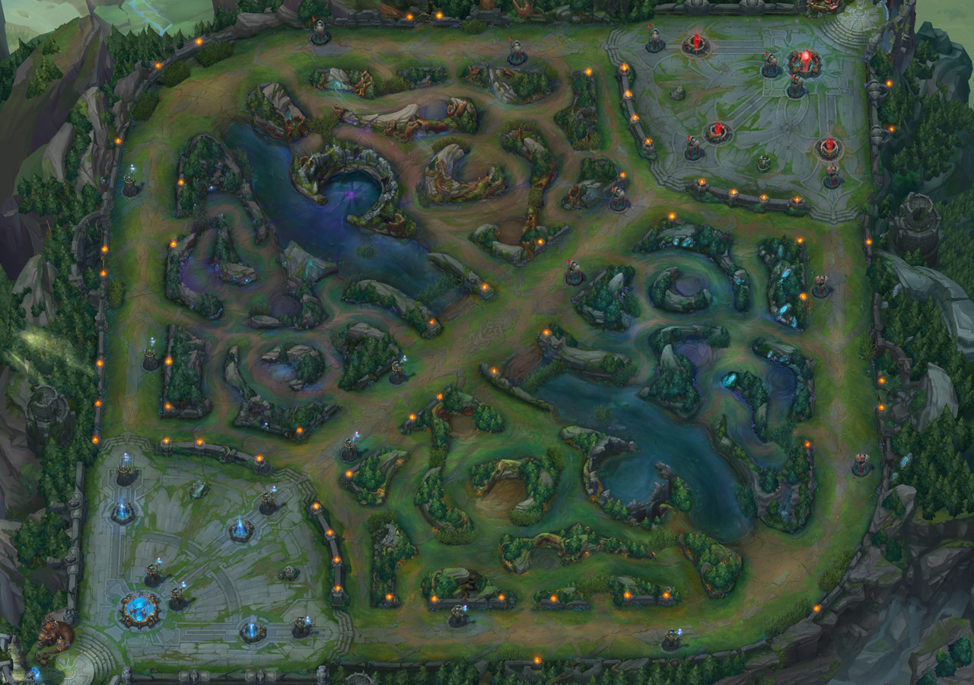
PART ONE Introduction
英雄聯盟 遊戲基本介紹：
玩家分成2隊，每隊5人，透過
破壞敵方主堡取得勝利。當中，角色的選擇、進攻的路線、順序以及策略都會影響整個過程。
Notes:
遊戲開始時,所有玩家操控的英雄都是1級，透過打小兵、破塔以及擊殺敵方玩家升級，英雄的能力值會提升，進而可以在戰場上殺敵更順暢。而在整個地圖上的兵力分配也相當重要，因為起初大家的能力值都不強，無法輕易破塔且敵人也不會比自己要牆上許多，所以通常採取分路進攻或防守，有時面對克制自己能力的英雄，必須與夥伴通力合作，所以可以透過誘敵的方式設下埋伏把敵人各個擊破，利用敵人死亡之後重生時間的空檔，再集中兵力進攻權力破塔以致主堡。

Slide 5
PART ONE Introduction
資料基本介紹
(資料來源：https://www.kaggle.com/datasnaek/league-of-legends/data)
世界大賽第7賽季
共取51490場比賽
比賽形式：積分對戰
解釋變數（候選）：
類別型：首殺、首塔、第一個被破壞的水晶兵營、第一隻被擊殺的Baron、第一隻被擊殺的Dragon、第一隻被擊殺的Rift Herald 、兩隊選擇的禁用的5個英雄（總共10個），每個玩家選擇的英雄（資料裡共有138種英雄）
連續型：遊戲時間、各隊兵營破壞數、各隊Baron擊殺數、各隊Dragon擊殺數、各隊Rift Herald擊殺數、各隊破塔數
應對變數：
Binary：Winner（1：第一隊，2：第二隊）

Slide 6
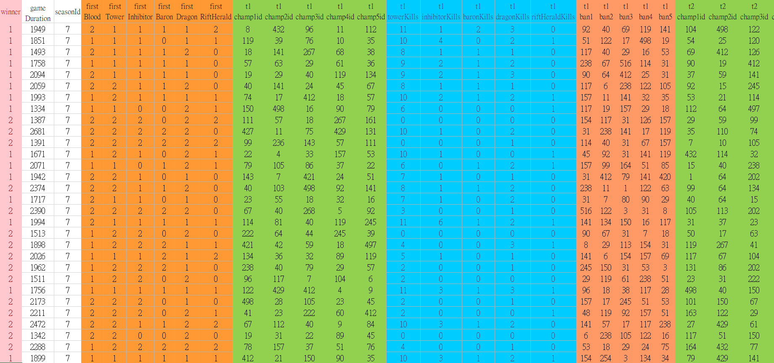
PART ONE Introduction
Notes:
前22筆

Slide 7
PART TWO
Exploratory Data Analysis

Slide 8
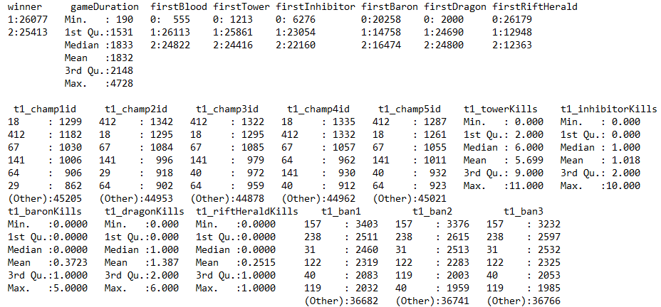
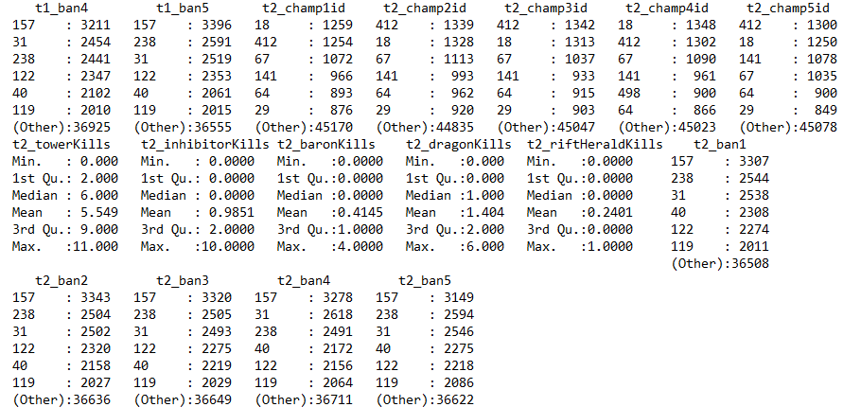
PART TWO 探索資料
Summary Statistics
We have originally 38 variables;
among them we have 27 categorical variables (marked by red)
of which one is binary (marked by blue)
and 6 are tenary (marked by purple).
The rest are continuous variables (marked by green).

Slide 9
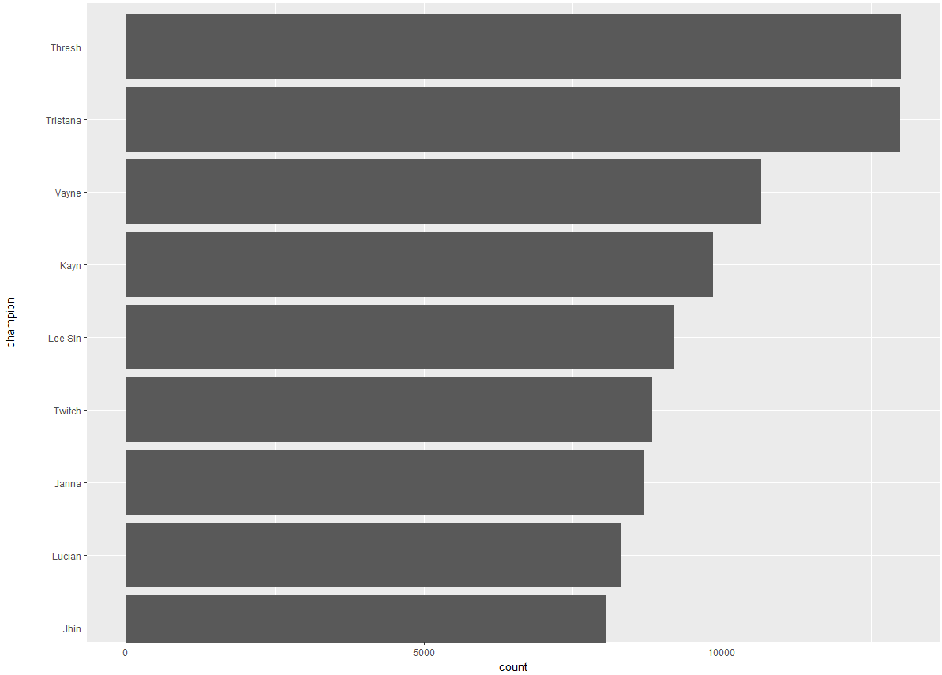
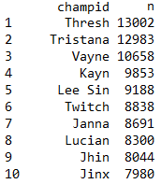
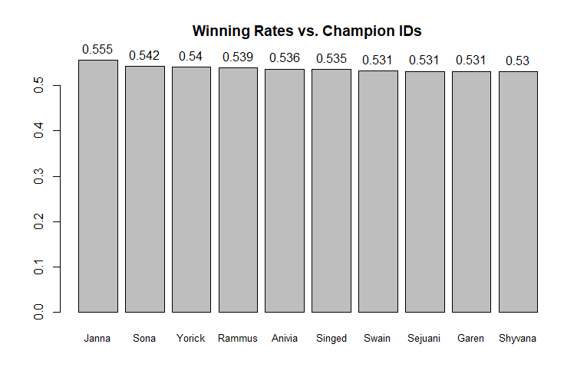
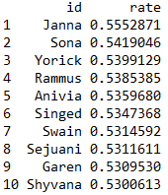
PART TWO 探索資料
Occurrences and Winning Rates of the Champions
The 10 highest number of the occurrences of the champions, combining both team 1 and team 2, is shown in the right figure.
We also present the 10 highest winning rates of the champions.
Occurrences or winning rates cannot purely determine a win alone!
We need to take them into account together.

Slide 10
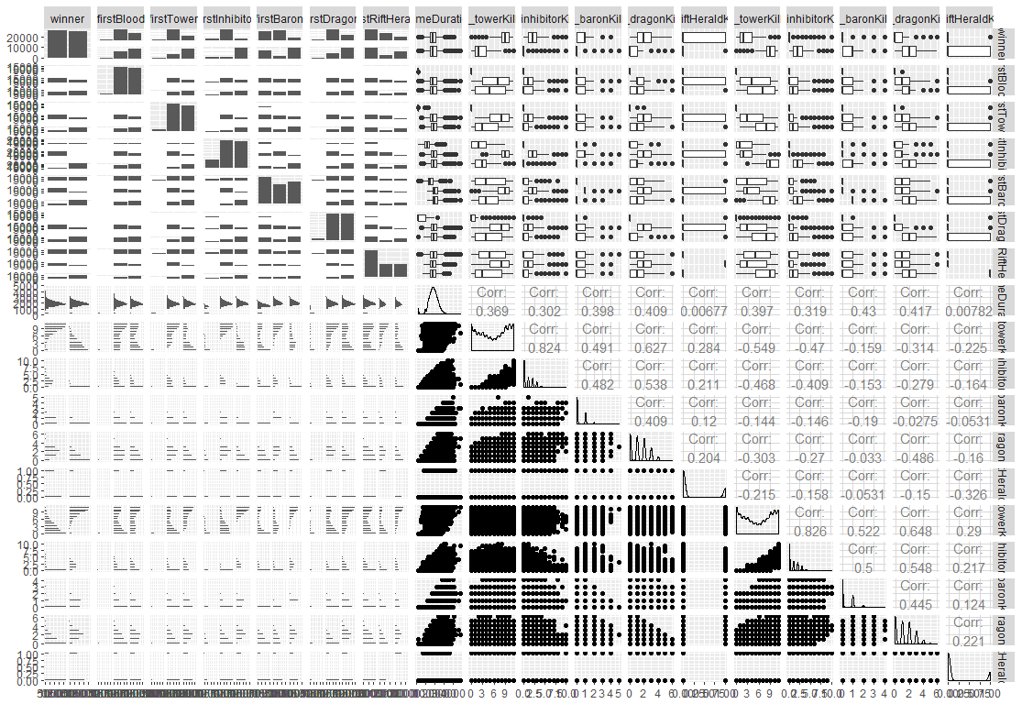
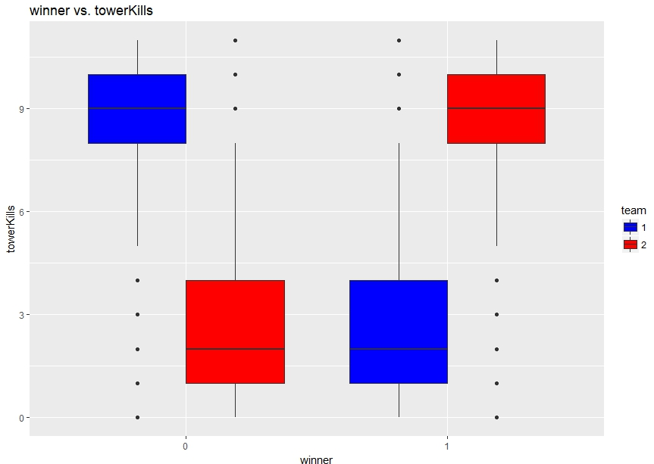
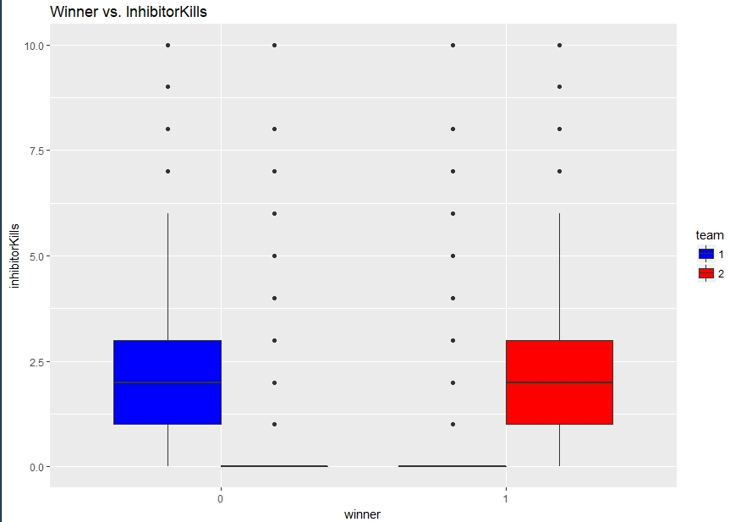
PART TWO 探索資料
Summary Plot by ggpairs
We exclude the players' champions, banned champions of two teams.
A win is determined heavily by towerKills and inhibitorKills!
The result shows pairwise relations for the remaining 18 variables.
Variables of interest are towerKills and inhibitorKills (marked by red).

Slide 11
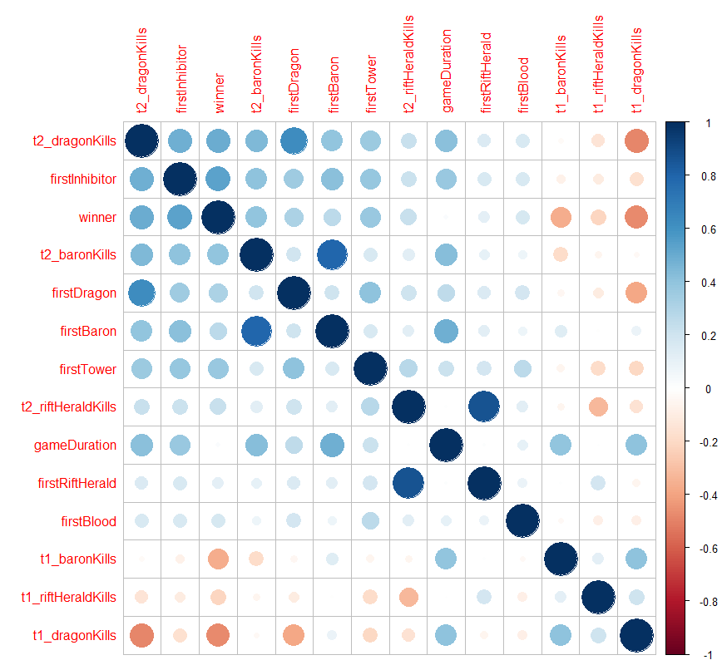
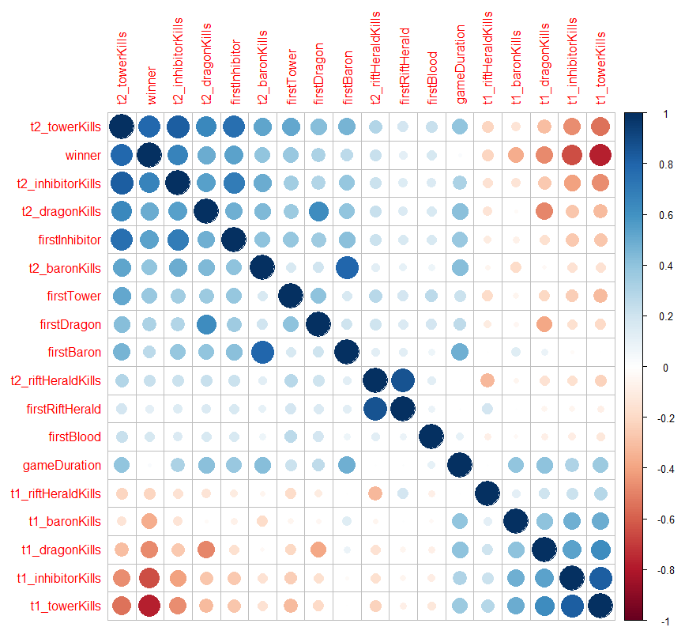
PART TWO 探索資料
Corrplot for 18 Variables
For building a prediction model, we would exclude t1_towerKills, t1_inhibitorKills, t2_towerKills and t2_inhibitorKills.
This plot orders the variables by the first principal component to better observe the variability within the data.
Focusing on the marked column (or the corresponding row),
almost more than half of the variables have correlation coefficients greater than 0.5 in magnitude.
A win is heavily determined by towerKills and inhibitorKills (marked by green)!

Slide 12
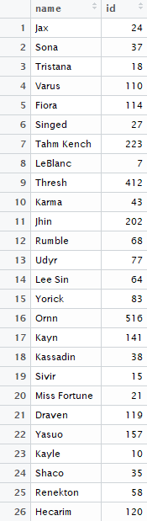
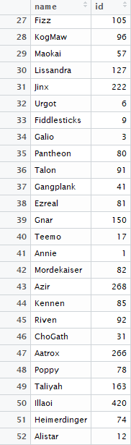
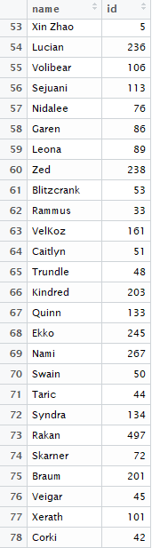
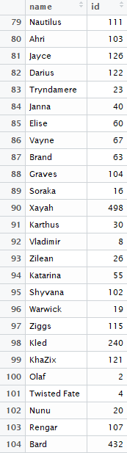
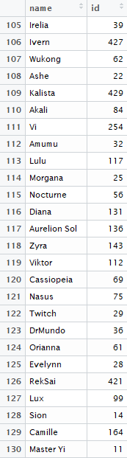
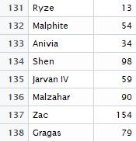

PART TWO 探索資料
Conversion to Our Actual Covariates
This is the entire list of the 138 champions.
01
We created 138*4=552 factors indicating whether team 1 (or team 2) has a particular champions or banned ones, respectively.
02
A huge factor set of size 51490*552 was created.
We are ready to talk about methods!
04
There are gameDuration, t1_baronKills, t1_dragonKills, t1_riftHeraldKills, t2_baronKills, t2_dragonKills, t2_riftHeraldKills
03
For the purpose of doing LASSO or group LASSO, we combined the factor set with "scaled" continuous variables.
05
06
Finally, the variables with prefix "first" were converted to factors as well
We obtained our actual covariates

Slide 13
PART THREE
Method

Slide 14
PART THREE Method
GLM (elastic net)
ridge
01
lasso
02
Elastic net
03
TITLE HERE
$l_{2}$ penalty
$l_{1}$ penalty
Mixture of $l_{1}$and $l_{2}$ penalty
When some covariates are highly corelated.
${\hat{β}}_{λ}^{ridge}$is biased and
has closed form.
Variable selection
(set some coefficients to 0)
${\hat{β}}_{λ}^{lasso}$ has no closed form
The elastic net combines the strength of ridge and lasso.

Slide 15
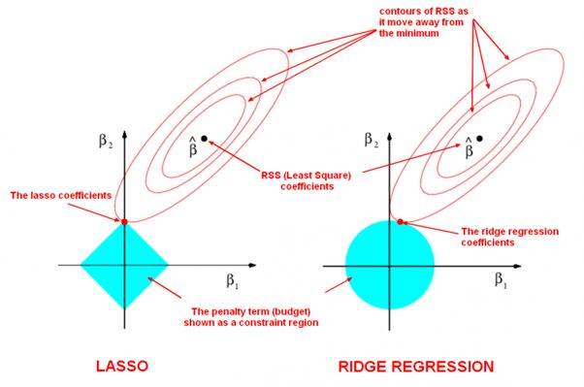


PART THREE Method
Ridge
$min {\left(y−Xβ\right)}^{T}\left(y−Xβ\right) s.t.\sum_{j=1}^{p}{β_{j}^{2}≤t}$
$${\hat{β}}_{λ}^{ridge}=(X^{T}X+λI_{p})^{−1}X^{T}Y$$
Lasso
$min$ ${\left(y−Xβ\right)}^{T}\left(y−Xβ\right) s.t.\sum_{j=1}^{p}{|β_{j}|≤t}$
${\hat{β}}_{λ}^{lasso}$ has no close form.

Slide 16
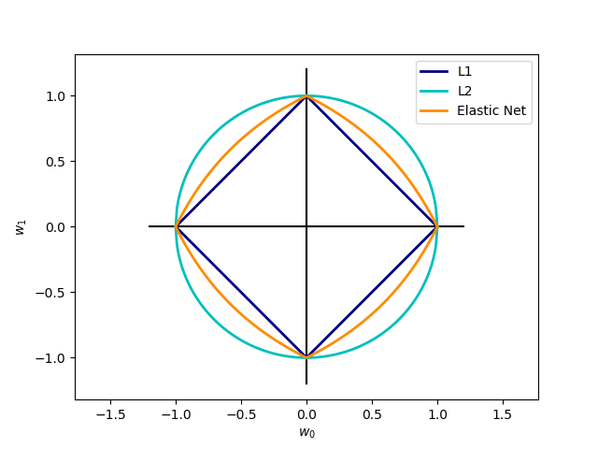
PART THREE Method
Elastic net
$$α\sum_{j=1}^{p}{{|β}_{j}|}+\left(1−α\right)\sum_{j=1}^{p}{β_{j}^{2}}≤t$$
$$P_{α,λ}=λ(α\sum_{i=1}^{p}{\left|β_{i}\right|}+\frac{1}{2}(1−α\sum_{i=1}^{p}{β_{i}^{2}}))$$
$$α∈\left[0,1\right],λ≥0$$

Slide 17
PART THREE Method
Group lasso
$$\min_{β∈R^{p}}{∥y−β_{0}−\sum_{l=1}^{L}{X_{l}β_{l}}∥_{2}^{2}+λ\sum_{l=1}^{L}{\sqrt{p_{l}}∥{β_{l}∥}_{2}}}$$
Divide the p parameter into L groups, $p_{l}$:the number of parameter in group$l$.
If the group size are all one, it reduces to lasso.
Select the variable in group level.
If one of parameter in a group is non zero, they will all be non-zero.

Slide 18
PART THREE Method
Group lasso
Use Blockwise Coordinate Desent to solve group lasso,we will get :
If ${\left\|X_{l}^{T}(y−{\hat{β}}_{0}−\sum_{k≠l}{X_{k}{\hat{β}}_{k}}) \right\|}_{2}<λ\sqrt{p_{l}}$ ,then ${\hat{β}}_{l}=0$
Otherwise ${\hat{β}}_{l}=\left(1−\frac{λ\sqrt{p_{l}}}{{\left\|s_{l}\right\|}_{2}}\right)s_{l},$ $s_{l}=X_{l}^{T}(y−{\hat{β}}_{0}−\sum_{k≠l}{X_{k}{\hat{β}}_{k}})$
Turn out to be a algorithm cycles around the k groups that ${\hat{β}}_{k}≠0$

Slide 19
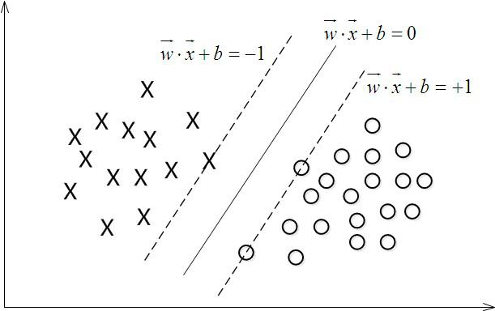
PART THREE Method
SVM
Find a classifier f such that
$$f(x_{i})\{_{<0 y_{i}=−1}^{≥0 y_{i}= +1}$$
i.e. $y_{i}f\left(x_{i}\right)>0$for a correct classification.
$$f\left(x\right)=W^{T}x+b$$
and max the margin $\frac{2}{\left\|W\right\|}$

Slide 20
PART THREE Method
SVM
The Lagrange function to be minimized w.r.t W and b :
$L_{p}=2^{−1}{\left\|W\right\|}^{2}−\sum_{i=1}^{n}{α_{i}\{y_{i}\left(W^{T}x_{i}+b\right)−1\}}$
$$⇒W= \sum_{i=1}^{n}{α_{i}y_{i}x_{i}},0=\sum_{i=1}^{n}{α_{i}y_{i}}$$
With the KKT conditions for SVM:
Stationarity : $W− \sum_{i=1}^{n}{α_{i}y_{i}x_{i}}=0 and \sum_{i=1}^{n}{α_{i}y_{i}}=0$
Primal admissibility : $y_{i}\left(w^{T}x_{i}+b\right)≥1,i=1,…,n$
Dual admissibility : $α_{i}≥0 ,i=1,…,n$
Complementarity : $α_{i}\left(y_{i}\left(W^{T}+b\right)−1\right)=0,i=1,…,n$
Then we get $α_{i}$ by maximizing $L_{d}$ with constraints:
$$L_{d}=\sum_{i=1}^{n}{α_{i}}−2^{−1}\sum_{i=1}^{n}{\sum_{j=1}^{n}{α_{i}α_{j}y_{i}y_{j}X_{i}^{T}X_{j}}},subject to α_{i}≥0 and \sum_{i=1}^{n}{α_{i}y_{i}}=0.$$

Slide 21
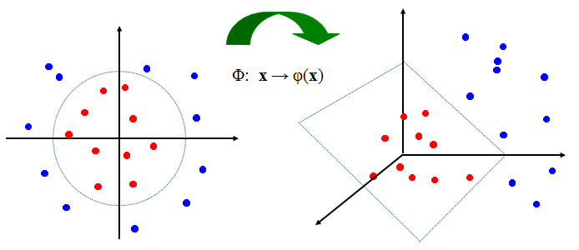

PART THREE Method
SVM
Introduce “slack”variable to allow error
We will get :
$$\min_{W∈R^{b},b}2^{−1}{\left|\left|W\right|\right|}^{2}+C\sum_{i=1}^{n}{ξ_{i}}$$
C is a cost parameter
Rewrite $ξ_{i}$, we can get :
$$\min_{W∈R^{b},b}\sum_{i=1}^{n}{{\left\{1−y_{i}f\left(x_{i}\right)\right\}}_{+}}{+2}^{−1}λ{\left|\left|W\right|\right|}^{2}$$
where ${\left\{1−y_{i}f\left(x_{i}\right)\right\}}_{+}=\max\left(0,1−y_{i}f\left(x_{i}\right)\right)and λ=1/C$
Nonlinear classifier
$$Φ :X→Φ\left(X\right) R^{d}→R^{D}$$
Radial basis function(RBF)： exp(-γ||x-y||2)

Slide 22
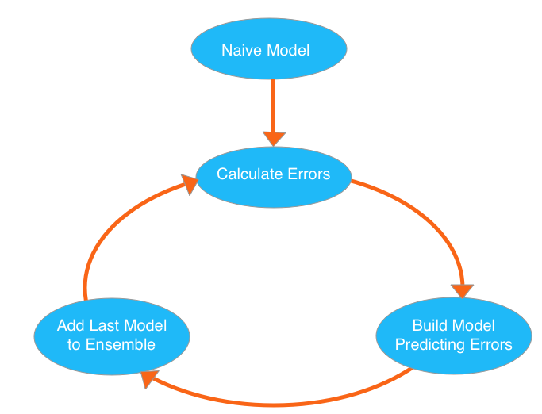

PART THREE Method
XGboost
$$Model :\hat{f}\left(x_{i}\right)=\sum_{m=1}^{M}{h_{m}\left(x_{i}\right)}$$
$$Object function : \sum_{i=1}^{n}{L(y_{i},\hat{f}(x_{i}))}+\sum_{m=1}^{M}{Ω(h_{m})}$$
With Taylor Expansion Approximation of Loss ,we get new goal for each iteration t:
$$\sum_{i=1}^{n}{[g_{i}h_{t}\left(x_{i}\right)+\frac{1}{2}s_{i}h_{i}^{2}(x_{i}) ]}+Ω(h_{t})$$
where $g_{i}=∂_{{\hat{f}}^{\left(t−1\right)}}L\left(y_{i},{\hat{f}}^{\left(t−1\right)}(x_{i})\right), s_{i}=∂_{{\hat{f}}^{\left(t−1\right)}}^{2}L\left(y_{i},{\hat{f}}^{\left(t−1\right)}(x_{i})\right)$

Slide 23
PART THREE Method
XGboost
We approximate $h_{t}\left(x\right)$ by tree :
$$h_{m}\left(x_{i}\right)≈\sum_{j=1}^{T}{w_{j}I\left(x∈R_{jt}\right)}$$
and define complexity as :
$$Ω\left(h_{t}\right)=γT+\frac{1}{2}λ\sum_{j=1}^{T}{w_{j}^{2}}$$
Then the optimal weight in each leaf, and the resulting objective value are
$$w_{j}^{∗}=−\frac{G_{j}}{S_{j}+λ}, Obj=−\frac{1}{2}\sum_{j=1}^{T}{\frac{G_{j}^{2}}{S_{j}+λ}}+γT$$
$$G_{j}=\sum_{i∈R_{jt} }{g_{i}},S_{j}=\sum_{i∈R_{jt}}{s_{i}}$$

Slide 24
PART THREE Method
XGboost
Greedy Learning Algorithm of Tree
$Gain=\frac{1}{2}[\frac{G_{L}^{2}}{S_{L}+λ}+$ $\frac{G_{R}^{2}}{S_{R}+λ}−\frac{G^{2}}{S+λ}]−γ$
Each iteration we grow a tree $h_{t}\left(x\right)$,instead of
$${\hat{f}}^{\left(t\right)}\left(x\right)={\hat{f}}^{\left(t−1\right)}\left(x\right)+h_{t}(x)$$
We use
$${\hat{f}}^{\left(t\right)}\left(x\right)={\hat{f}}^{\left(t−1\right)}\left(x\right)+νh_{t}(x)$$
$$ν is the learning rate$$

Slide 25

PART THREE Method
Random Forest
$$Generate ntree with mytry node$$
And use the all tree to vote final prediction
Bagging : Bootstrap aggregating
Ensemble Method
OOB : out of bag

Slide 26
PART FOUR
Data Analysis

Slide 27
PART FOUR Data Analysis
(0) 資料處理
1. 資料分割: 將51490筆資料，拆分成80% training data，20% testing data
資料標準化: 針對連續型和類別型(ordinal) X 做標準化，其餘類別型(nominal)則建立dummy variable

Slide 28
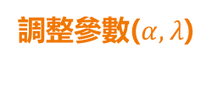



PART FOUR Data Analysis
(1) GLM (Lasso)
Step1
01
Step2
02
Step3
03
Step4
04
TITLE HERE
調整參數($α,λ$)
變數選擇
配適模型
預測
利用5-fold CV同時調整($α,λ$)
使得Validation data AUC最大
由於調整過程中$α$值變動很大
給定 $α$=1
使用步驟一的($α,λ$)
用Elastic net的方法找出
重要變數
使用步驟一的($α,λ$) 和
步驟二選出的變數
Fit 一個 logistic regression
重複步驟一到步驟三100次
計算平均的prediction accuracy
並畫出個別的ROC curve

Slide 29
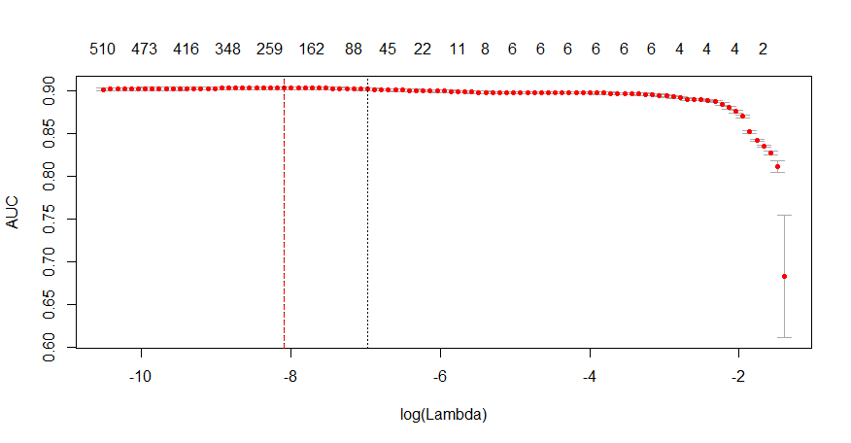
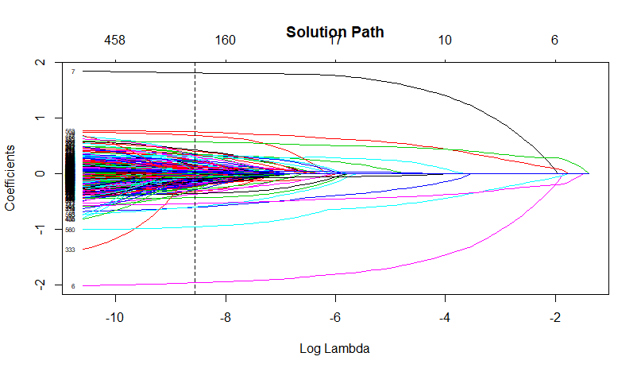
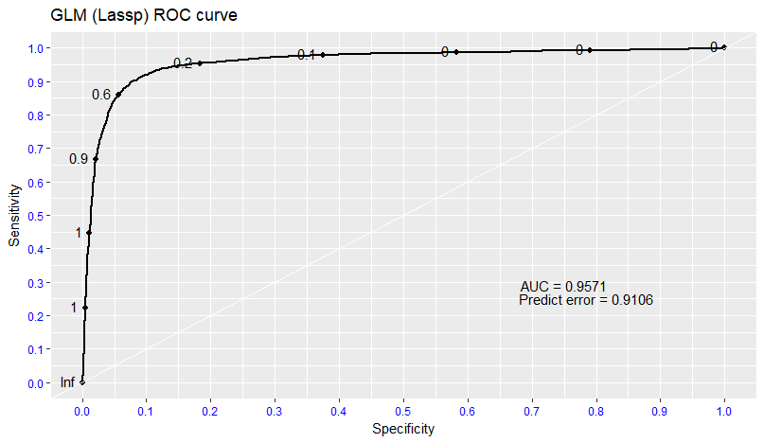
PART FOUR Data Analysis
(1) GLM (Lasso)
 | True(0) | True(1)
Predict(0) | 4879 | 454
Predict(1) | 467 | 4498
1.調整參數
3.混淆矩陣
GLM
2.重要變數
4.ROC 曲線
1-

Slide 30


PART FOUR Data Analysis
(2) GLM (Group Lasso)
Step1
01
Step2
02
Step3
03
Step4
04
TITLE HERE
變數分群
調整參數 (𝜆)
配適模型
預測
將 covariate 依照特性分群
如類別變數的 dummy variable 與某英雄在兩隊伍的出現與否
利用 5-fold CV 調整$λ$
使得 Classification error 最小
使用步驟二的 $λ$ Fit 一個 logistic regression with grouped covariate
重複步驟二與步驟三100次
計算平均的 prediction accuracy
並畫出個別的 ROC curve

Slide 31
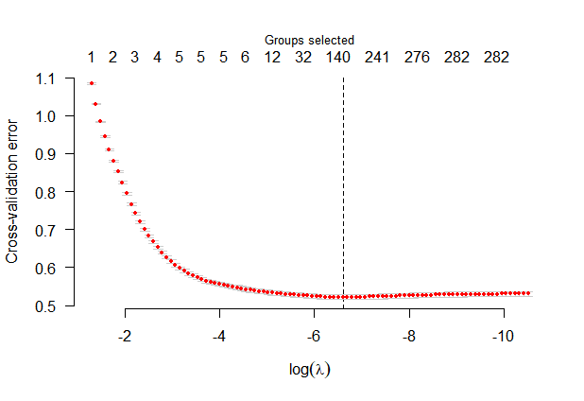
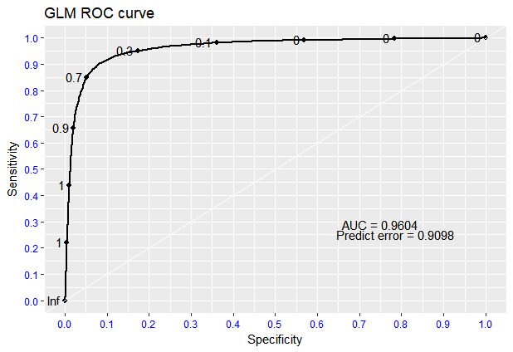
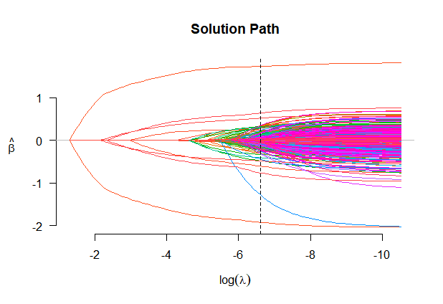
PART FOUR Data Analysis
(2) GLM (Group Lasso)
 | True(0) | True(1)
Predict(0) | 4792 | 451
Predict(1) | 478 | 4577
1.調整參數
3.混淆矩陣
GLM
(GLasso)
2.重要變數
4.ROC 曲線
1-

Slide 32
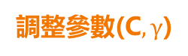


PART FOUR Data Analysis
(3) SVM
Step1
01
Step2
02
Step3
03
TITLE HERE
調整參數(C$,γ$)
配適模型
預測
利用5-fold CV同時調整(C$,γ$)
使得Classification error最小
由於tune時間過久，選預設值(1,0.0017)
使用步驟一的(C$,γ$)
配適SVM模型
計算 prediction accuracy
並畫出個別的 ROC curve

Slide 33
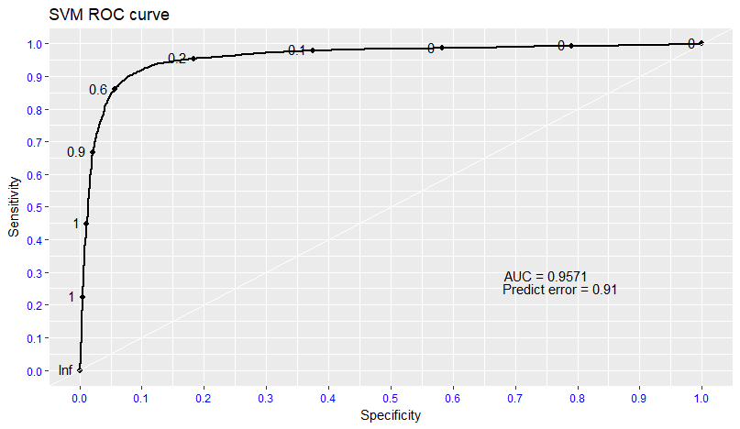
PART FOUR Data Analysis
(3) SVM
1.調整參數
 | True(0) | True(1)
Predict(0) | 4889 | 483
Predict(1) | 444 | 4482
SVM
2.混淆矩陣
3.ROC 曲線
1-

Slide 34
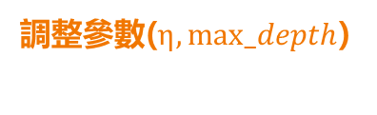


PART FOUR Data Analysis
(4) XGboost
Step1
01
Step2
02
Step3
03
TITLE HERE
調整參數($η,max_depth$)
配適模型
預測
利用5-fold CV調整($η,max⁡_depth$)
使得Validation data AUC最大
並找尋最佳的$nround$
※ $η$: learning rate
※ $max⁡_depth$: maximum depth of a tree
※ $nround$: number of rounds for boosting
使用步驟一的($η,$ $max⁡_depth$,$nround$)
配適 XGboost 模型
重複步驟一到步驟二100次
計算平均的prediction accuracy
並畫出個別的ROC curve

Slide 35
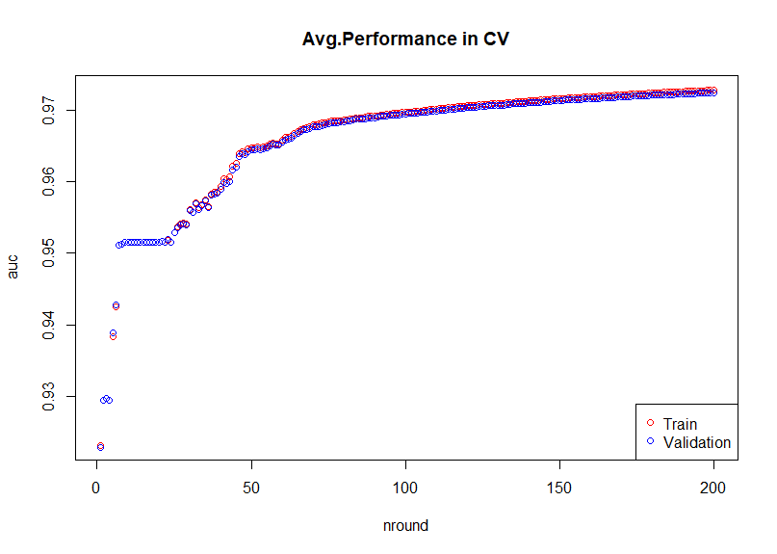
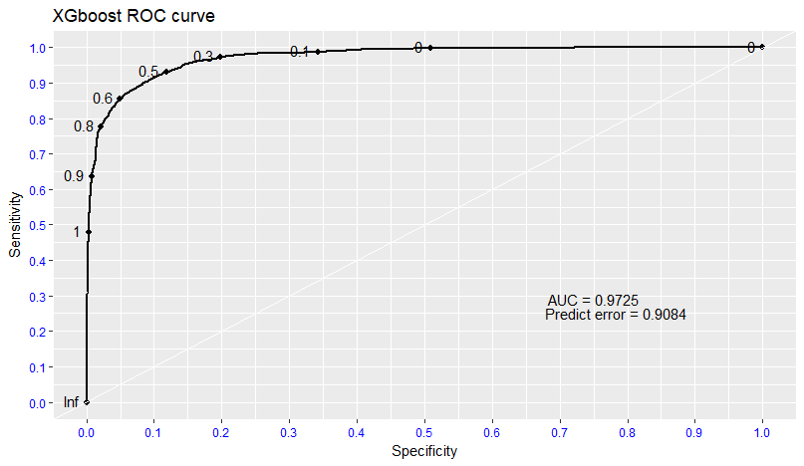
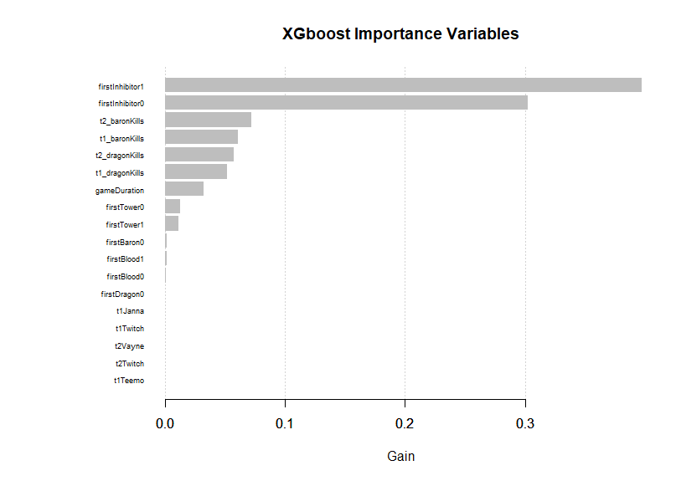
PART FOUR Data Analysis
(4) XGboost
 | True(0) | True(1)
Predict(0) | 4888 | 445
Predict(1) | 498 | 4467
1.調整參數
3.混淆矩陣
XGboost
2.重要變數
4.ROC 曲線
1-

Slide 36
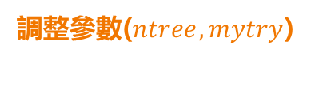


PART FOUR Data Analysis
(5) Random Forest
Step1
01
Step2
02
Step3
03
TITLE HERE
調整參數($ntree,mytry$)
配適模型
預測
$ntree$:找出讓classification error收斂的地方
$mytry$:找出OOB值最小的
使用步驟一的($ntree,mytry$)
配適Random Forest 模型
計算 prediction accurate
並畫出個別的 ROC curve

Slide 37
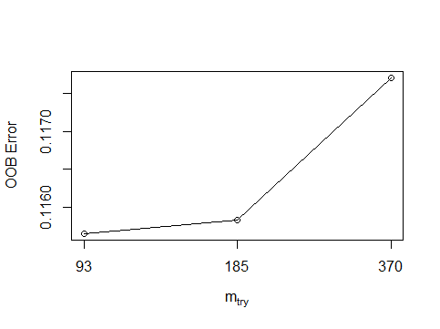
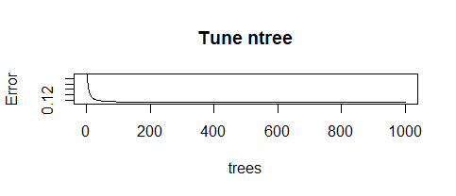
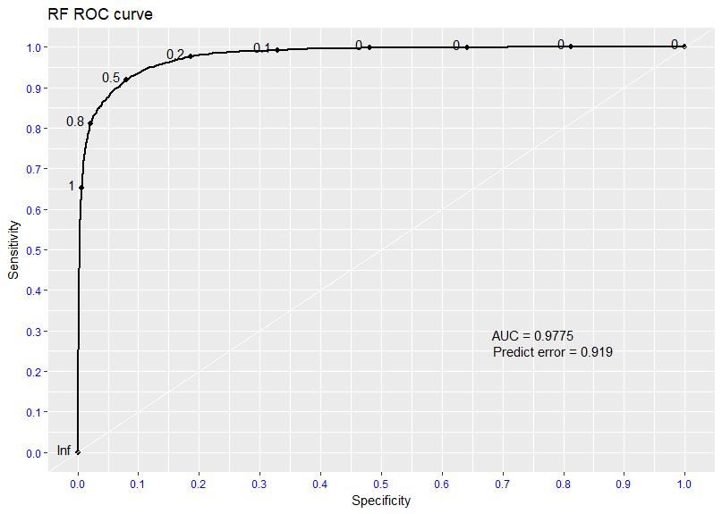
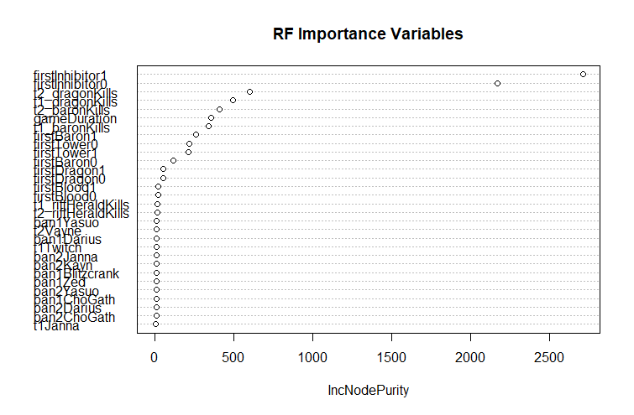
PART FOUR Data Analysis
(5) Random Forest
 | True(0) | True(1)
Predict(0) | 4912 | 413
Predict(1) | 421 | 4552
1.調整參數
3.混淆矩陣
RF
2.重要變數
4.ROC 曲線
1-

Slide 38
PART FIVE
Discussion

Slide 39

PART FIVE Discussion
Random Forest
AUC
97.75%
Predicted accuracy
91.90%

Slide 40
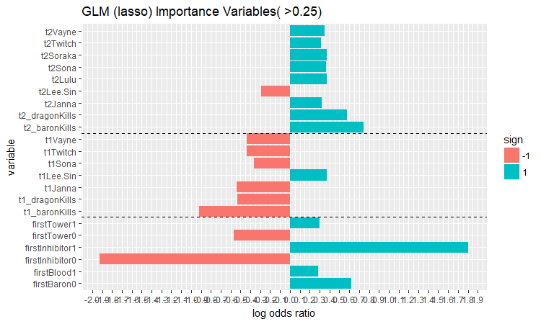
PART FIVE Discussion
GLM (Lasso)

Slide 41
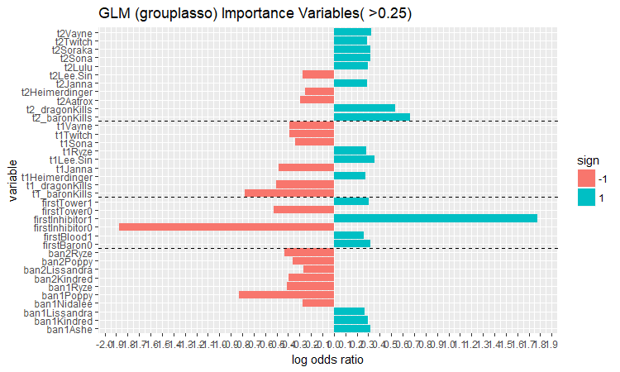
PART FIVE Discussion
GLM (GLasso)

Slide 42
PART FIVE Discussion
XGboost

Slide 43
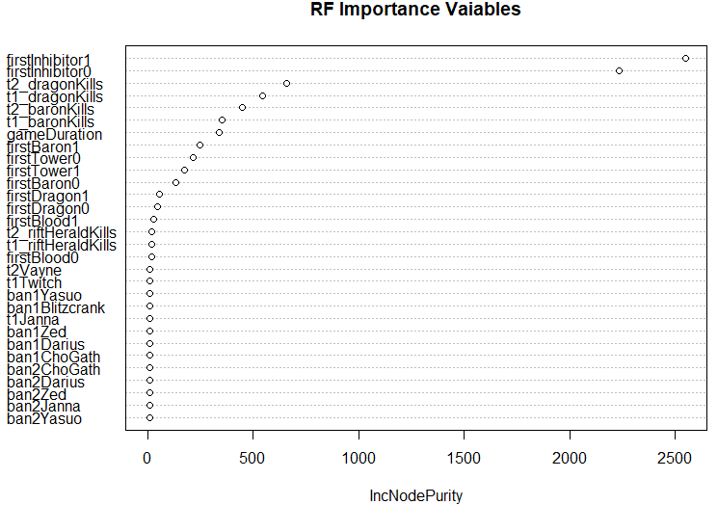
PART FIVE Discussion
RF

Slide 44
REFERENCES
League of Legends Match Outcome Prediction, Lucas Lin, 2016
League of Legends: The Meta as a Function of Time and Rank, Bryant Chen ,Ted Li and Sean Rafferty, 2016

Slide 45
THANK YOU
FOR
WATCHING

